Slide 1
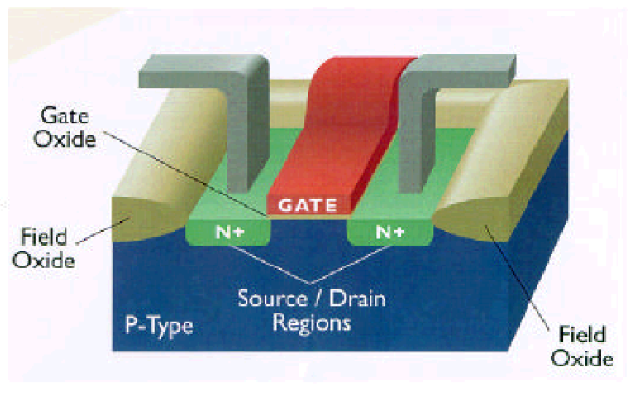
The MOS Transistor
Polysilicon
Aluminum
JFET – Junction Field Effect Transistor
MOSFET - Metal Oxide Semiconductor Field Effect Transistor
n-channel MOSFET (nMOS) & p-channel MOSFET (pMOS)

Slide 2
The MOS Transistor
Gate Oxide
Gate
Source
Polysilicon
Field-Oxide
Drain
(SiO
2
)
n+
n+
p-substrate
p+ stopper
Bulk Contact
CROSS-SECTION of NMOS Transistor
Notes:
The MOS transistor, or MOSFET is a very simple device to manufacture. It also lends itself to high scale integration. Several thousand devices can be manufactured on a single chip without the devices interacting with one another.
Heavily doped n-type source and drain regions are implanted (diffused) into a lightly doped p-type substrate (body). A thin layer of SiO2 (gate oxide) is grown over the region between the source and drain and is covered by a polysilicon gate.
Neighboring devices are shielded with a thick layer of SiO2 (field oxide) and a reverse-biased np-diode formed by adding a an extra P+ region (channel-stop implant or field implant)
When a voltage larger than the threshold voltage, VT is applied to the gate, a conducting channel is formed between drain and source. Current can then flow from drain to source through the channel if there exists a potential difference between them.
Current is carried by electrons in an NMOS transistor. This is unlike a diode where both electrons and holes carry the current though different types of material.

Slide 3
Switch Model of NMOS Transistor
| V_{GS} |
Gate
Source
(of carriers)
Drain
(of carriers)
Open (off) (Gate = ‘0’)
Closed (on) (Gate = ‘1’)
R_{on}
| V_{GS} | < | V_{T} |
| V_{GS} | > | V_{T} |
Notes:
Fourth terminal, body (bulk on previous slide)- substrate, not shown.
Assumed connected to the appropriate supply rail, GND for NMOS, VDD for PMOS
Electrons flow from source to drain – so current is referenced drain to source (IDS)
Performs very well as a switch, little parasitic effects
Today: STATIC (steady-state view) and later DYNAMIC (transient view)
VGS < 0.43 V for off
VGS > 0.43 V for on

Slide 4
Switch Model of PMOS Transistor
| V_{GS} |
Gate
Source
(of carriers)
Drain
(of carriers)
Open (off) (Gate = ‘1’)
Closed (on) (Gate = ‘0’)
R_{on}
| V_{GS} | > | V_{DD} – | V_{T} | |
| V_{GS} | < | V_{DD} – |V_{T}| |
Notes:
holds flow source to drain – so current is referenced source to drain (ISD)
VGS > 2.5 - .4 = 2.1 V for off
and Vgs < 2.1 V for on

Slide 5
MOS transistors Symbols
D
D
G
G
S
S
Channel
NMOS
Enhancement
NMOS
Depletion
D
D
G
G
B
S
S
PMOS
Enhancement
NMOS with
Bulk Contact
Notes:
MOS transistors can be either enhancement (no channel at VGS = 0) or depletion (finite channel at VGS = 0) types. Notice the thick line on the symbol that represents the channel.
All MOSFET transistors actually have 4 pins (including the base [substrate] pin). Since the substrates are connected to the supply lines in digital circuits, they are typically not drawn.

Slide 6
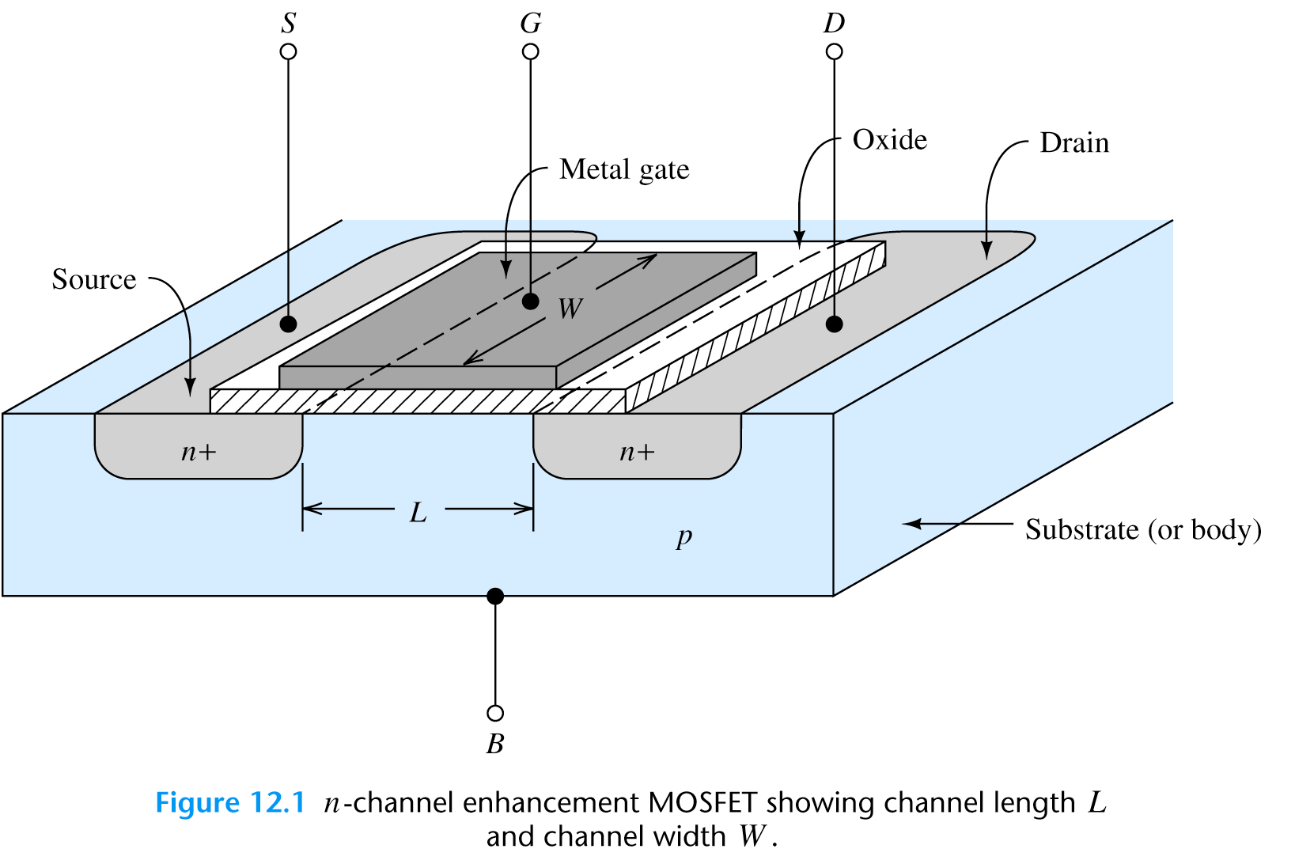
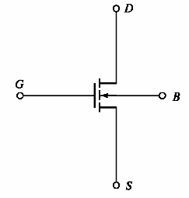
JFET and MOSFET Transistorsor
Symbol
L = 0.5-10 μm
W = 0.5-500 μm
SiO₂ Thickness = 0.02-0.1 μm
Device characteristics depend on L,W, Thickness, doping levels

Slide 7
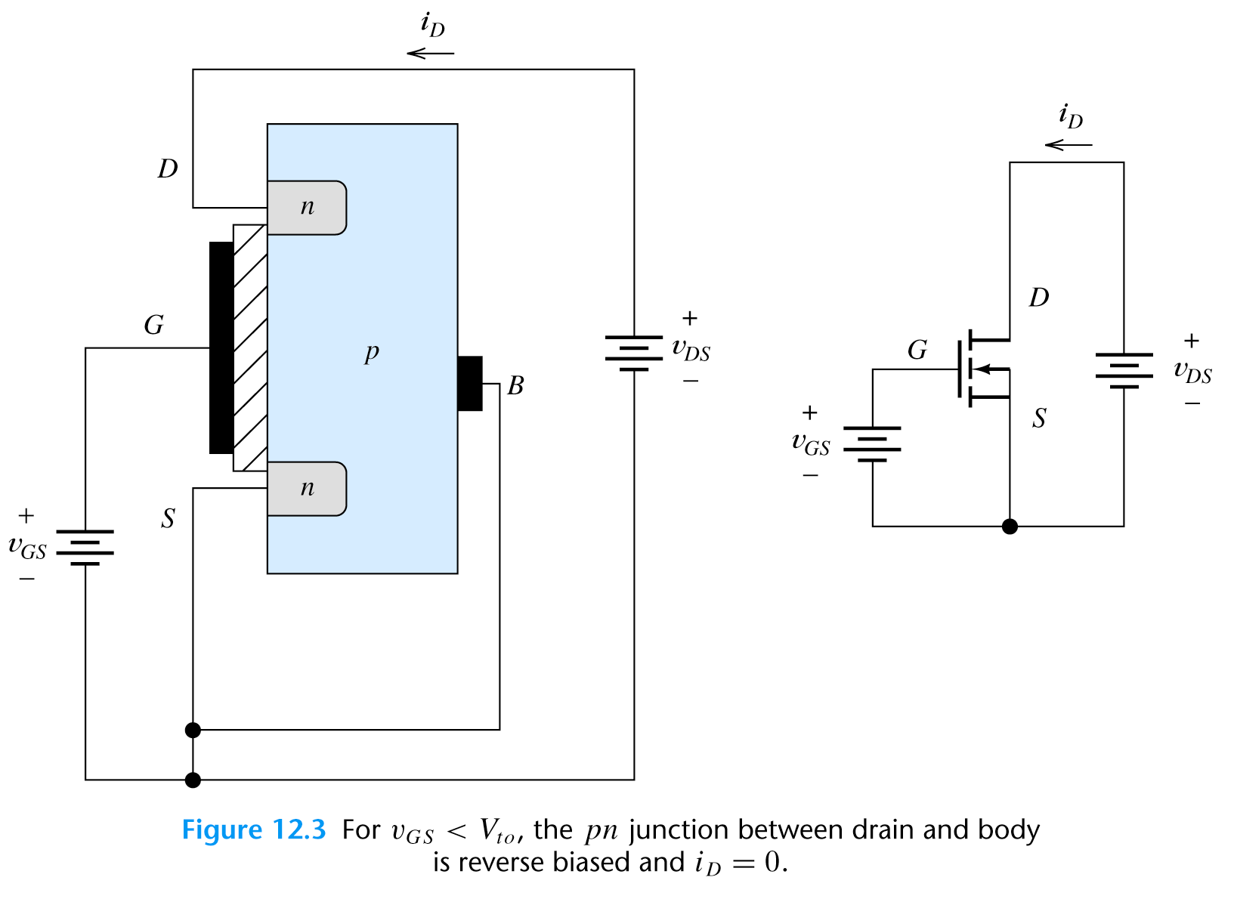
n-channel MOSFET Basic Operation
Operation in the Cutoff region
pn junction: reverse bias
i_{D}=0
for v_{GS}<V_{t0}
Schematic
When v_{GS}=0 then i_{D}=0 until v_{GS}>V_{t0} (V_{t0} –threshold voltage)

Slide 8
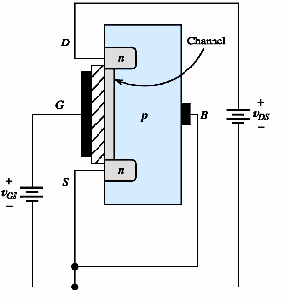
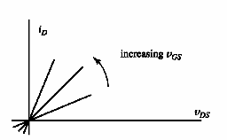
n-channel MOSFET Basic Operation
Operation in the Triode Region
For v_{DS}<v_{GS}-V_{t0} and v_{GS}>V_{t0} the NMOS is operating in the triode region
Resistor like characteristic
(R between S & D,
Used as voltage controlled R)
For small v_{DS}, i_{D} is proportional
to the excess voltage v_{GS}-V_{t0}

Slide 9
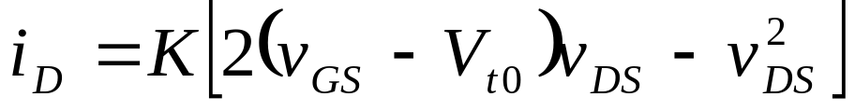
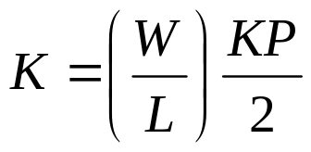
n-channel MOSFET Basic Operation
Operation in the Triode Region
Device parameter KP for
NMOSFET is 50 μA/V²

Slide 10
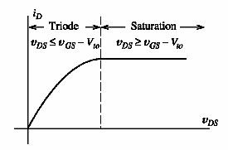
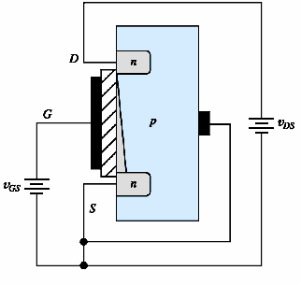
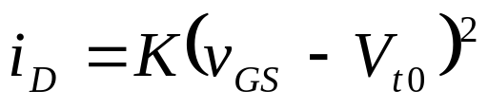
n-channel MOSFET Basic Operation
Operation in the Saturation Region (v_{DS} is increased)
Tapering
of the
channel
- increments
of i_{D} are
smaller
when
v_{DS} is
larger
When v_{GD}=V_{t0} then the channel
thickness is 0 and

Slide 11
n-channel MOSFET Basic Operation
Example 12.1
An nMOS has W=160 μm, L=2 μm, KP= 50 μA/V² and V_{to}=2 V.
Plot the drain current characteristic vs drain to source voltage
for v_{GS}=3 V.

Slide 12
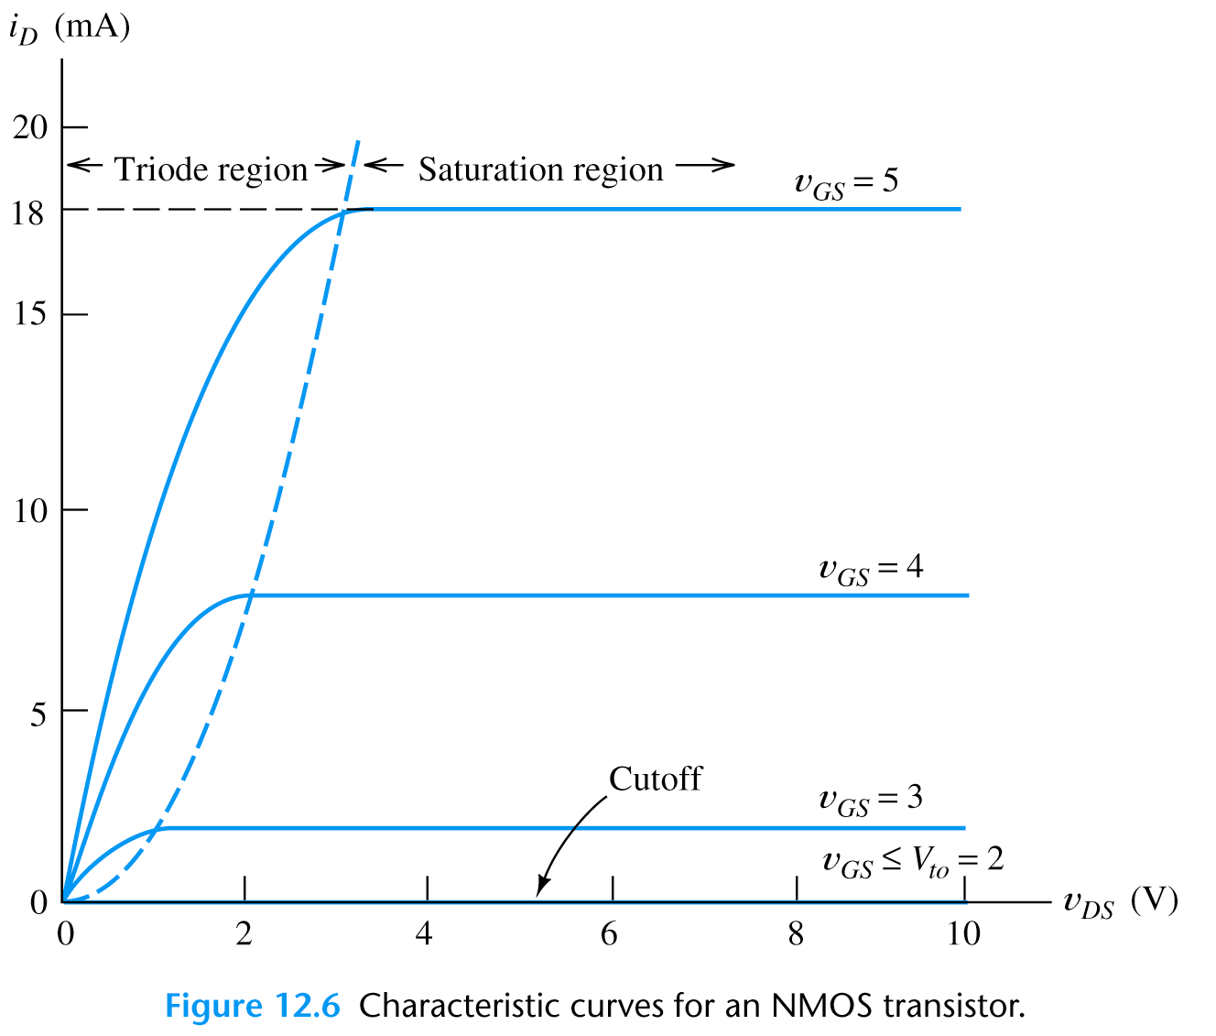
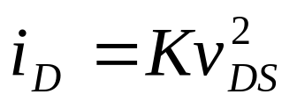
n-channel MOSFET Basic Operation
Example 12.1
Characteristic
Channel length
modulation
i_{d} depends on v_{DS} in saturation region
(approx: i_{D} =const in saturation region)

Slide 13
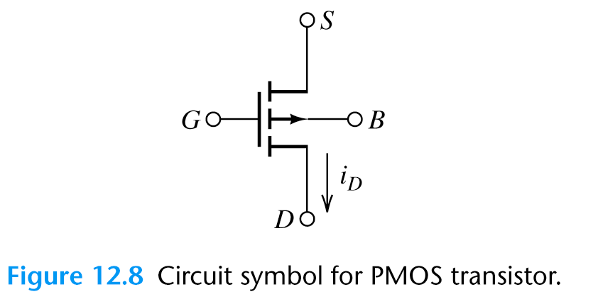
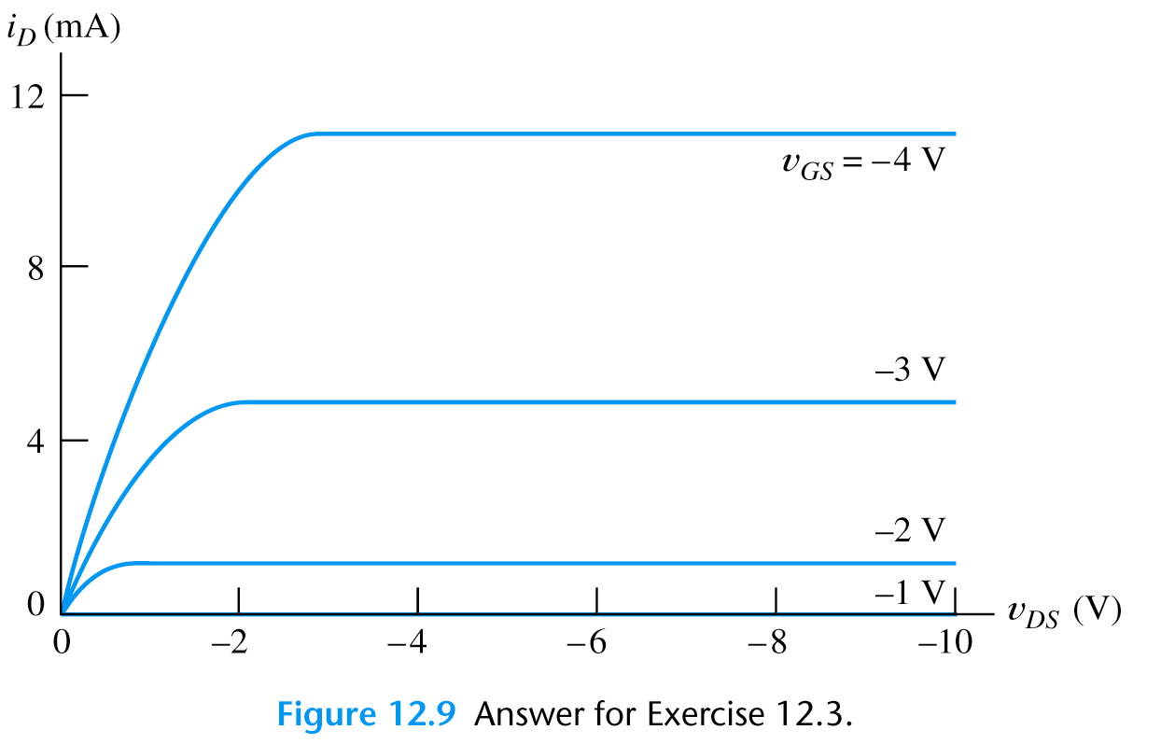
p-channel MOSFET Basic Operation
It is constructed by interchanging the n and p regions of n-channel MOSFET.
Symbol
Characteristic
How does p-channel MOSFET operate?
-voltage polarities
-i_{D} current
-schematic

Slide 14
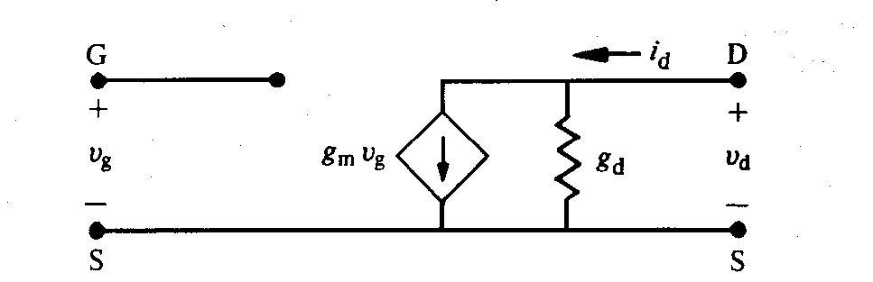
Equivalentna šema u oblasti zasićenja
Gate se ponaša kao otvoreno kolo
S-D izlazno kolo se ponaša kao strujni izvor

Slide 15
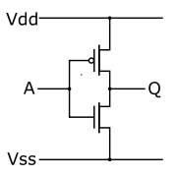
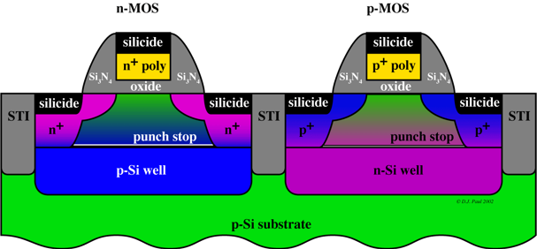
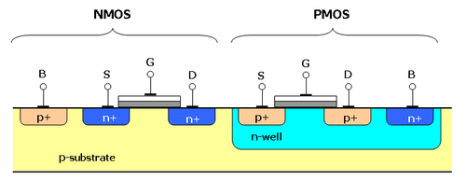
CMOS
NOT gate
(inverter)

Slide 16
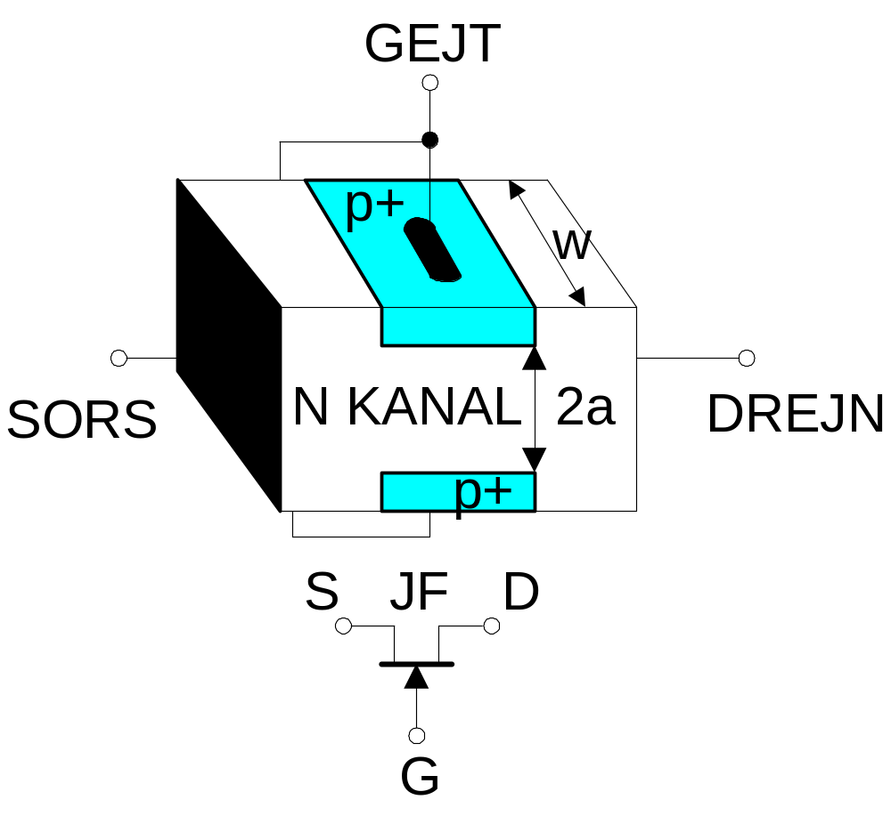
Konstrukcija JFET - a

Slide 17
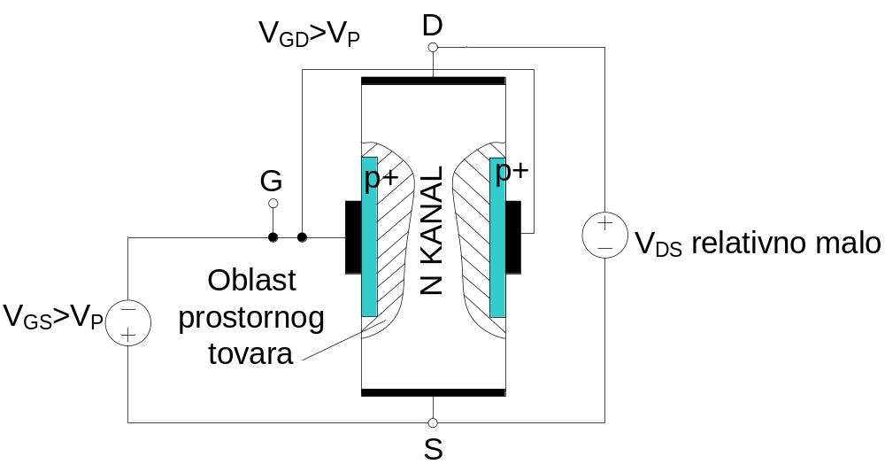
Geometrija provodnog kanala u omskoj oblasti rada JFET –a

Slide 18
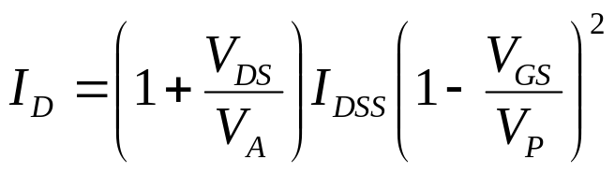
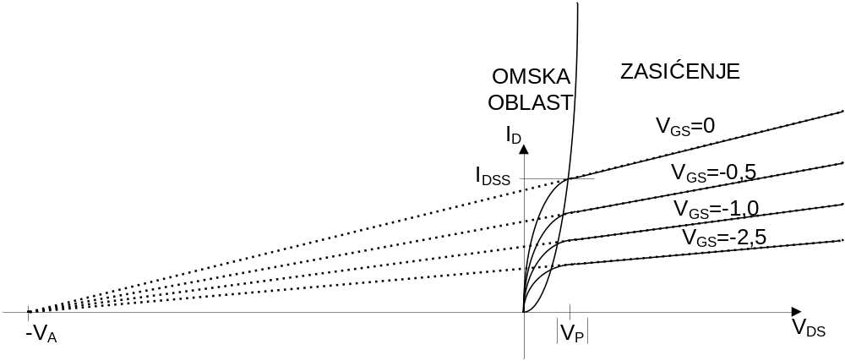
Izlazna karakteristika JFET -a
Uštinućam kanala, tj. povećanje napona V_{DS} ipak dovodi do smanjenja dužine neuštinutog dela kanala i tako da se izlazne karakteristike u izvesnoj meri iskose
Ova pojava može se modelovati po ugledu na bipolarne tranzistore sa erlijevim naponom V_{A}, data izrazom

